Slide 1
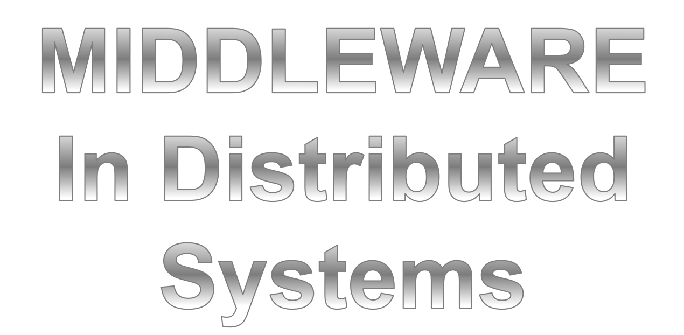

Slide 2
Middleware Emergence
Distributed computing evolved from single-tier (terminal/mainframe) to 2-tier (client-server) to n-tier architecture (separates processing to different servers)
To support heterogeneous environments open networking standards were introduced (i.e. OSI)
How do we build/connect applications over a network?
Answer: middleware

Slide 3
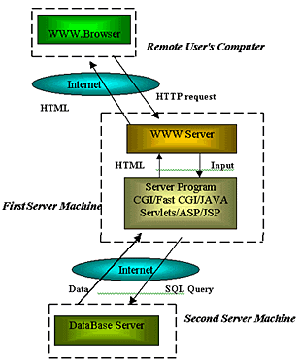
N-tier architecture
More scalable architecture that separates processing to different servers

Slide 4
Introduction
Middleware is computer software that connects distributed software components or applications.
The distributed software consist of a set of services that allows multiple processes running on multiple machines to interact across a network.
Middleware shields the developer from dependencies on Network Protocols, OS and hardware platforms.
Middleware sits “in the middle” between application software working on different Operating Systems.

Slide 5
Need of Middleware
Middleware reduces application development and maintenance efforts.
Middleware provides distributed computing.
Distributed application without middleware are impractical.

Slide 6
Middleware Basics
Middleware are sets of distributed software that provides functionality beyond that provided by the operating system to enable the components of distributed system to communicate and manage data.This increased functionality allow applications to:
Locate transparently across the network.
Be independent from network services.
Be reliable and available.
Scale up in capacity without losing functionality.

Slide 7
Categories of Middleware
There are different kinds of middleware, they are:
Transaction Processing (TP) Monitor Technology.
Message Oriented Middleware (MOM).
Remote Procedure Call (RPC).
Homegrown Middleware Solutions
Common Object Request Broker Architecture CORBA.

Slide 8
Transaction Processing Monitors
Transaction Processing Monitors are used to coordinate and monitor the processes from various application in a distributed environment.
Products: Tuxedo, IBM CICS, Microsoft Transaction Server
Client App
App1
TPM
App2
App3

Slide 9
Homegrown Middleware
Customized to meet specific needs
Needs substantial investments
Pros
Can meet specific needs
Cons
Not cost effective
Lacks scalability

Slide 10
Message Oriented
Data is transferred between applications as a message
Mode Of Communication : Asynchronous
Basic Components of MOM
1.Message (Information that needs to be transferred)
2.Queue (A container used to store and distribute messages)
Types Of MOM
1. Message Queuing (Store and Forward)
2. Publish / Subscribe
Products: IBM WebSphere MQ, TIBCO Rendezvous

Slide 11
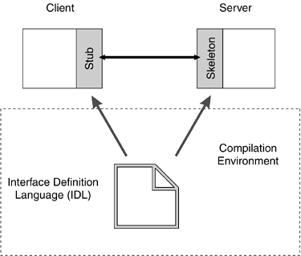
Remote Procedure calls
Procedure/Function Oriented
Follows the Request/Reply Model
Mode of Communication is synchronous
Provides Location/Platform transparency
Technologies: ONC RPC, DCE/RPC

Slide 12
Common Object Request Broker Architecture (CORBA)
Driven by Microsoft and Object Management Group (OMG).
It’s a standard architecture for distributed object systems.
It allows distributed, heterogeneous collection of object to interoperate.
The concepts are defined in such a way that they can be mapped to a number of programming languages.
It does not include language constructs to store variables or to express algorithms.

Slide 13
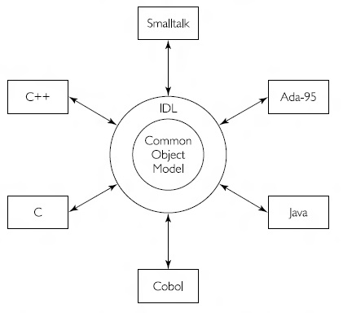
CORBA (Contd…)
The Interface Definition Language (IDL) is designed to be independent of a particular programming language, though its syntax is oriented towards C++.
CORBA defines bindings to: C, C++, Smalltalk, Ada, Java and Cobol. These programming language binding determines how object type operations are implemented in server object and how client can make object request.

Slide 14
Component of CORBA
Client Stubs create and issue requests on the client side.
Dynamic invocation is done by Dynamic Invocation Interface, Here control is recursively given back to the client object until it polls for operation result.
ORB Interface Interact between Object Request Broker(ORB Core), Client and Server Objects at run time .
ORB activate the object using Object Adapter.
Implementation Skeletons receive and forward requests to objects on the server side. The skeleton finally calls the operation that was requested by the client.
Notes:
stub is a piece of code that converts parameters passed between the client and server during a remote procedure call (RPC).
RPC allows a local computer (client) to invoke procedures on a remote computer (server).
Client and server have different address spaces, the parameters used in a function call must be converted. Otherwise, the parameter values would be unusable because pointers to parameters in one computer's memory would reference different data on the other computer.
Also, client and server can have different data representations, even for simple parameters like integers (e.g., big-endian versus little-endian).
Stubs handle parameter conversion, making a remote procedure call look like a local function call to the remote computer.

